Slide 1
Forecasting Analysis Report
Sample : MRTSSM4441USN
Presented by Nguyen Dam Phuc Anh, ID: 24116258

Slide 2
1) Introduction & Objective
A strategic business plan relies on accurate forecasts as the key to effective resource allocation, risk management, and decision-making.
To meet this need, an econometric analysis was conducted to identify the most reliable model for predicting future sales.
This report documents the statistical foundation of the projections using time series forecasting methods, beginning with an overview of the data, methodology, and the three forecasting models evaluated.

Slide 3
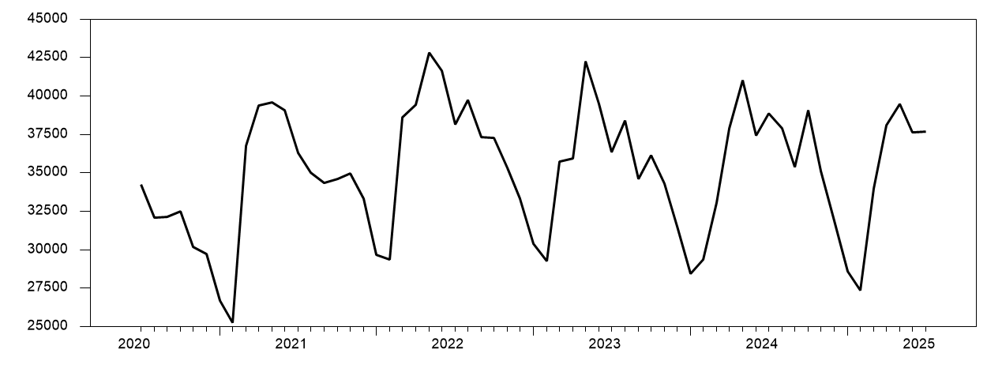
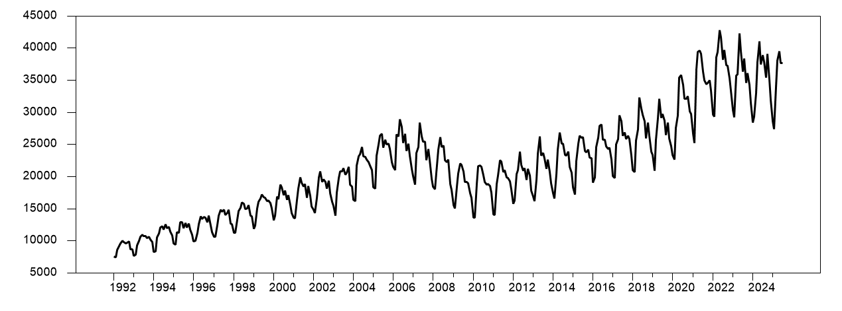
Remote collaboration tools
2) Data overview
This is the graph of the data on Retail Sales: Building Materials and Supplies Dealers from the U.S. Census Bureau, spanning January 1992 to July 2025.
It illustrates a long-term upward trend in retail sales, showing peaks and troughs through out the period.
The data demonstrate strong resilience during the COVID-19 period (2020–2021), experiencing only a brief dip before reaching new highs.
The analysis period (July 2020 – July 2025) was chosen to capture the post-pandemic recovery phase, providing a more representative view of current market dynamics.
The h-steps ahead WS forecast are 6.
Period: 2020:07–2025:07
Period: 1992:07–2025:07

Slide 4
3.1) The three models used.
ES Smoothing Model
Box-Jenkins Model
Metronome Model
The ES model assigns greater weight to recent data, smoothing random variation and capturing short-term trends. However, it fails to fully reflect the five-month cyclical pattern, causing higher forecast errors compared to the Metronome model.
A widely-used statistical model that identifies and forecasts patterns based solely on a time series own historical data. It analyzes relationships between a value and its past values, as well as its past forecast errors, to make predictions.
The Metronome model combines a quadratic trend with a five-month seasonal pattern, effectively capturing both long-term movement and periodic fluctuations. It achieves lower MAE and MAPE, producing smoother and more realistic forecasts than alternative models.

Slide 5
3.2 WS forecast with recursive estimation & OOS forecast
Within Sample forecast is when the model is used to predict the outcome using a data point from the sample data that was used to develop and optimize the model.
Out of Sample forecast is when the model is used to predict the outcome using a data point that was not a part of the sample data that was used to develop and optimize the model.

Slide 6
Model | Test | Statistic Value | Significance Level (P-value)
Model 1: ES | Mincer-Zarmowitz Rationality test 1 | 2.93595 | 0.08201006
 | SIGN test 1 | 0.852803 | 0.39376863
 | Pesaran Timmerman test with variations 1 (PT) | 3.122183 | 0.00179515
Model 2: Box-Jenkins | Mincer-Zarmowitz Rationality test 2 | 0.72503 | 0.49955736
 | SIGN test 2 | -1.2792 | 0.20082512
 | Pesaran Timmerman test with variations 2 (PT) | 2.596371 | 0.00942144
Model 3: Metronome | Mincer-Zarmowitz Rationality test 3 | 0.24478 | 0.78575911
 | SIGN test 3 | 1.279204 | 0.20082512
 | Pesaran Timmerman test with variations (PT) 3 | 2.640235 | 0.00828485
4. Comparative Analysis and Model Selection
All models passed both optimality and accuracy tests, confirming statistical validity.
Forecast accuracy reflects the average forecast error during back testing — lower values indicate better performance.
Key metrics assessed:
  RMSE (Root Mean Square Error)
  MAE (Mean Absolute Error)
  MAPE (Mean Absolute Percentage Error)
Model Comparison:
  Both Exponential Smoothing (Model 1) and Metronome (Model 3) outperformed the ARIMA model, showing comparable accuracy.
Model Selection:
  The Metronome Model (Model 3) was chosen as the official forecasting model.
Rationale:
  Demonstrates stronger structural integrity and better interpretability.
  Captures the quadratic trend and five-month seasonal cycle, providing a clear economic rationale and more reliable forecasts.
Model | Root Mean Square Error (RMSE) | Mean Absolute Error (MAE) | Mean Absolute Pct Error (MAPE)
Model 1: ES | 1499.40 | 1322.31 | 3.77%
Model 2: ARIMA | 1923.42 | 1600.79 | 4.58%
Model 3: Metronome | 1695.49 | 1318.26 | 3.69%

Slide 7
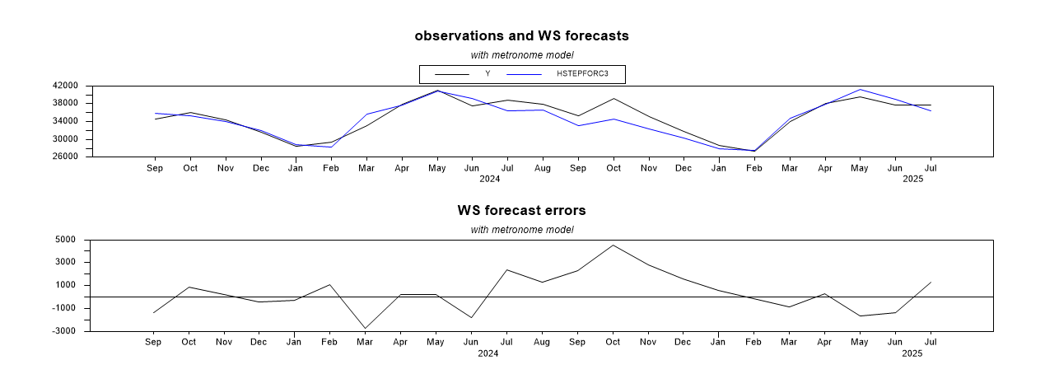
5. Model Selection for forecasting.
It is recommended to adopt the "Metronome" (Model 3) for future forecasting activities.
Superior accuracy: Achieved the lowest MAE and MAPE, proving its forecasts were closest to actual outcomes.
Statistical reliability: Back testing confirms unbiased forecasts with strong directional accuracy, showing it can anticipate trends effectively.
Interpretability: Its hybrid structure integrates trend and seasonality transparently, allowing easy understanding and adjustment to business changes.
Balanced Performance & Practicality: Although the ES model captures some unique data, the “Metronome” model’s superior accuracy, lack of bias, and interpretability make it the most robust and practical choice for strategic planning.

Slide 8
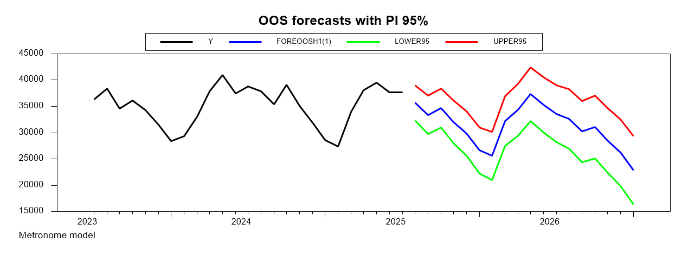
6. Forecasting Results.
Understanding Forecast Uncertainty
A forecast is not a single, fixed number — it represents the most likely outcome within a range.
This range is captured by Prediction Interval (PI), which express the degree of confidence in the forecast.
For example, a 95% Prediction Interval means we are 95% confident the actual value will fall within that range.
PI account for:
  Unpredictable future shocks to the economy
  Uncertainty in the model’s estimated parameters.
The interval widens over time. It indicates increasing uncertainty in long-term projections.
  → Our confidence in precise future values decreases as we look further ahead.

Slide 9
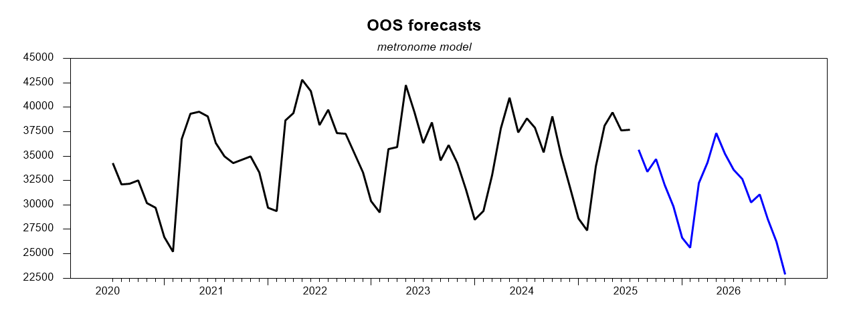
18-Month Out-of-Sample Forecast
The following graph presents the 18-month out-of-sample forecast generated by the recommended "Metronome" model, from August 2025 to January 2027. It includes the point forecast along with the 95% lower and upper prediction bounds.

Slide 10
6. Conclusion
→ The forecast suggests a drop, so preparing for lower revenue, reduced production, or inventory adjustments are necessary.
Here are some recommendations:
Short-term: Monitor indicators closely and respond to any rebound signals early.
Medium-term: Plan for resource optimization — reduce unnecessary spending or output.
Long-term: Investigate root causes of the decline (market trends, competition, external shocks).

Slide 11
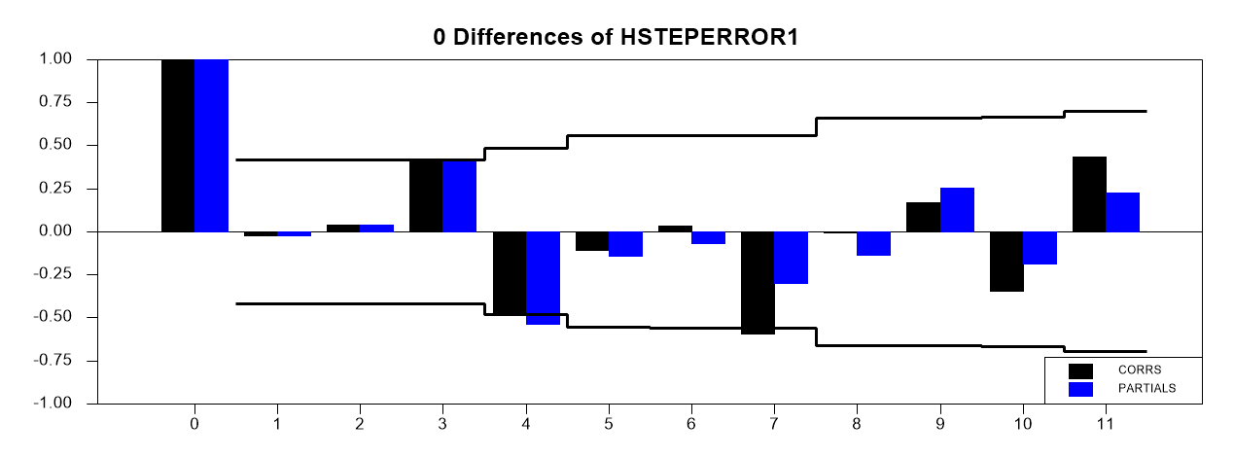
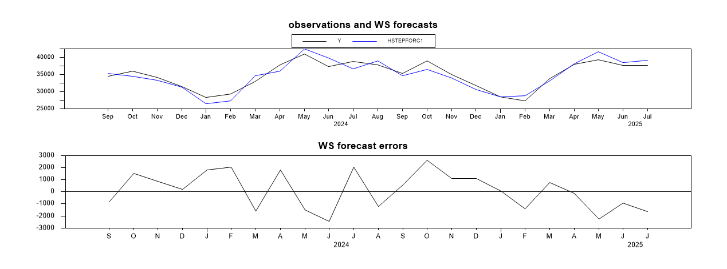
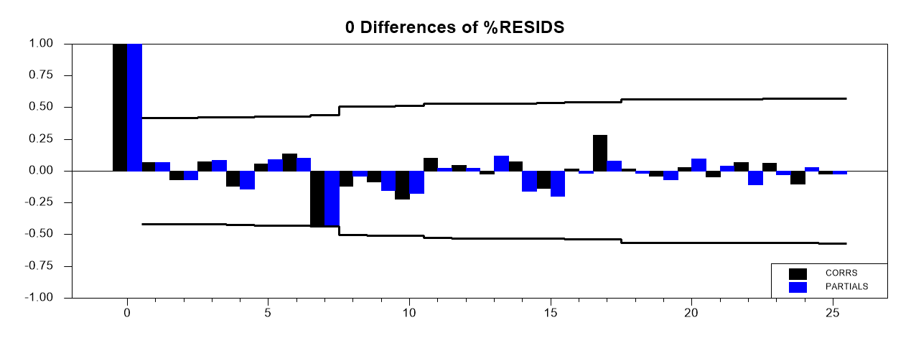
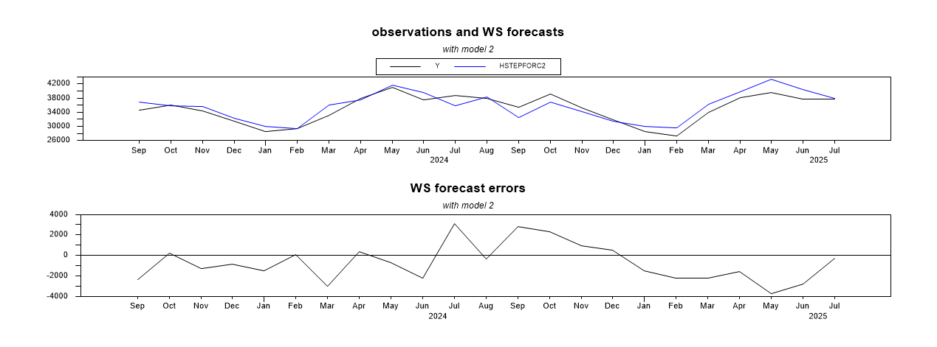
Appendix

Slide 12
Forecast results
Entry LOWER95 Forecast Result UPPER95
2025:08 32342.696687 35686.493899 39030.291110
2025:09 29750.571538 33399.273621 37047.975703
2025:10 31007.747102 34688.968197 38370.189292
2025:11 27959.609733 32032.114852 36104.619972
2025:12 25605.860700 29840.012700 34074.164699
2026:01 22239.122471 26636.326411 31033.530350
2026:02 21002.568098 25600.647943 30198.727788
2026:03 27482.250886 32240.764579 36999.278272
2026:04 29446.510946 34369.172562 39291.834178
2026:05 32268.270682 37352.610607 42436.950532
2026:06 30041.794953 35278.315312 40514.835672
2026:07 28222.501882 33609.161774 38995.821667
2026:08 27024.333316 32654.078239 38283.823162
2026:09 24428.562904 30235.422886 36042.282869
2026:10 25138.068796 31092.228719 37046.388641
2026:11 22438.176044 28567.774171 34697.372299
2026:12 19918.217112 26203.570032 32488.922952
2027:01 16431.280173 22869.347638 29307.415104

Slide 13
Thank you!

